Slide 1

KPMG Virtual Internship Data Analysis
Trend analysis (Module 3)

Slide 2
Your best quote that reflects your approach… “It’s one small step for man, one giant leap for mankind.”
- Neil Armstrong

Slide 3
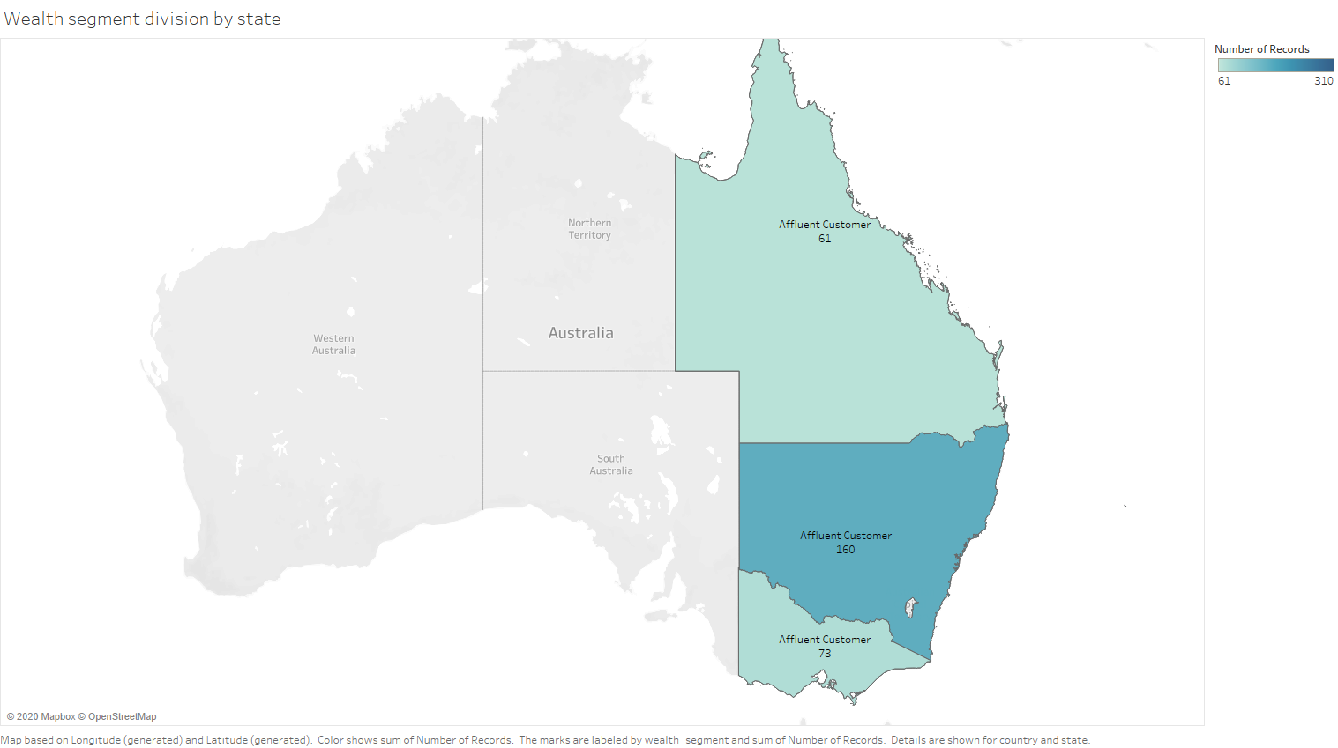
State wise wealth segmentation

Slide 4
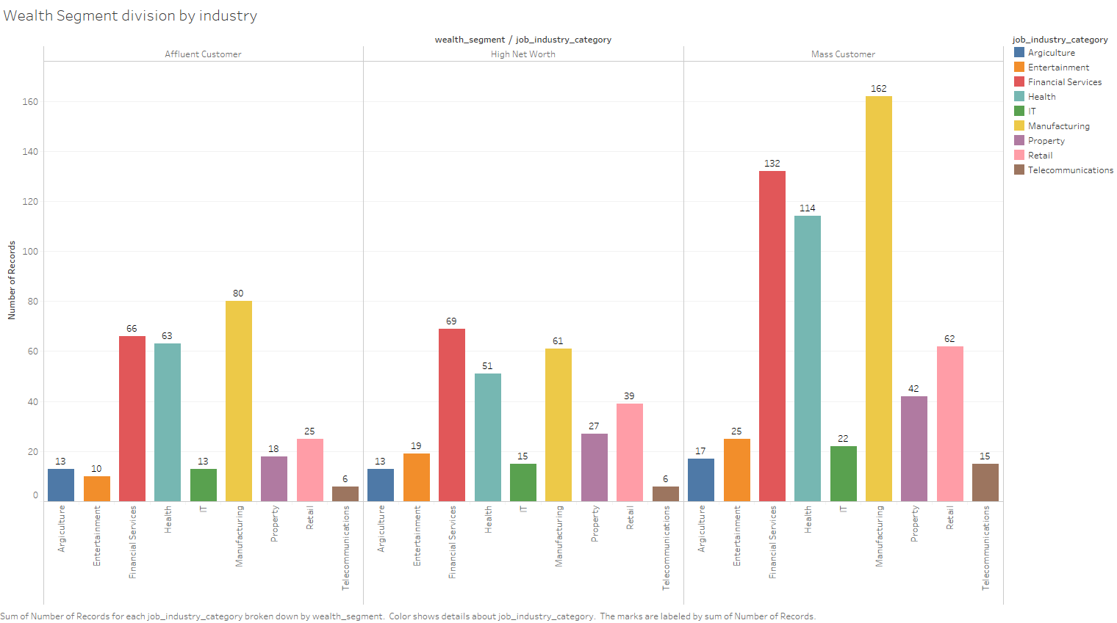
Wealth segmentation by Industry

Slide 5
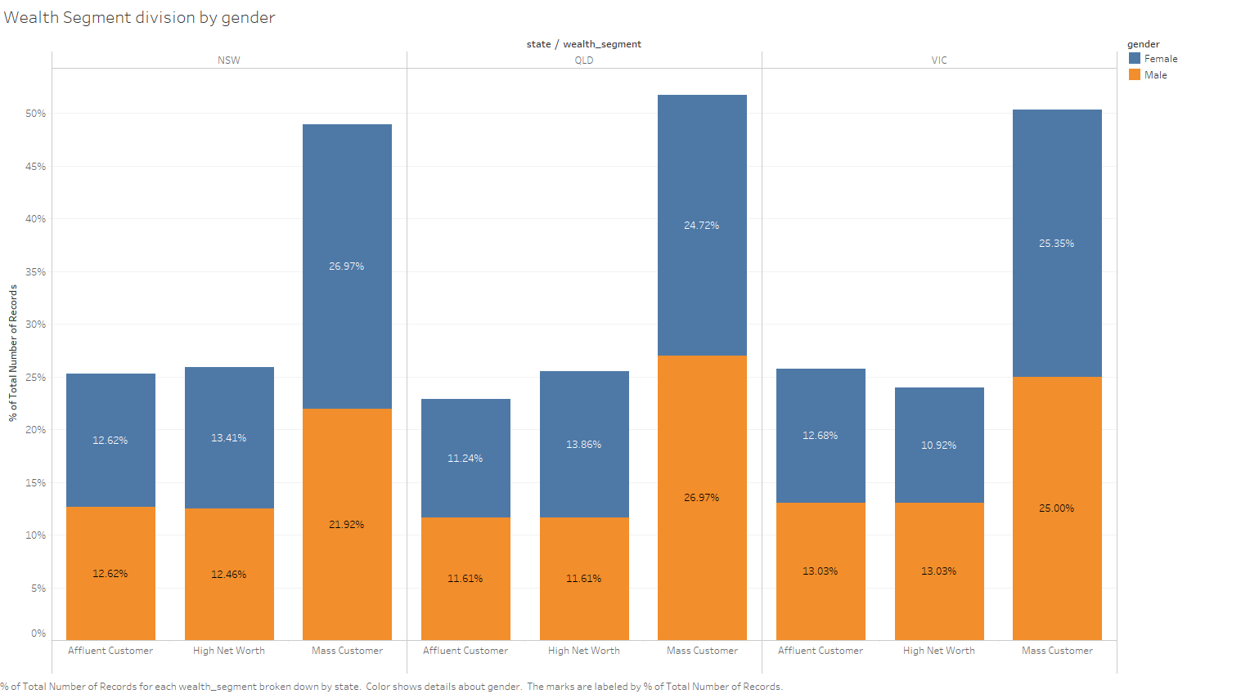
Wealth segmentation by Gender

Slide 6
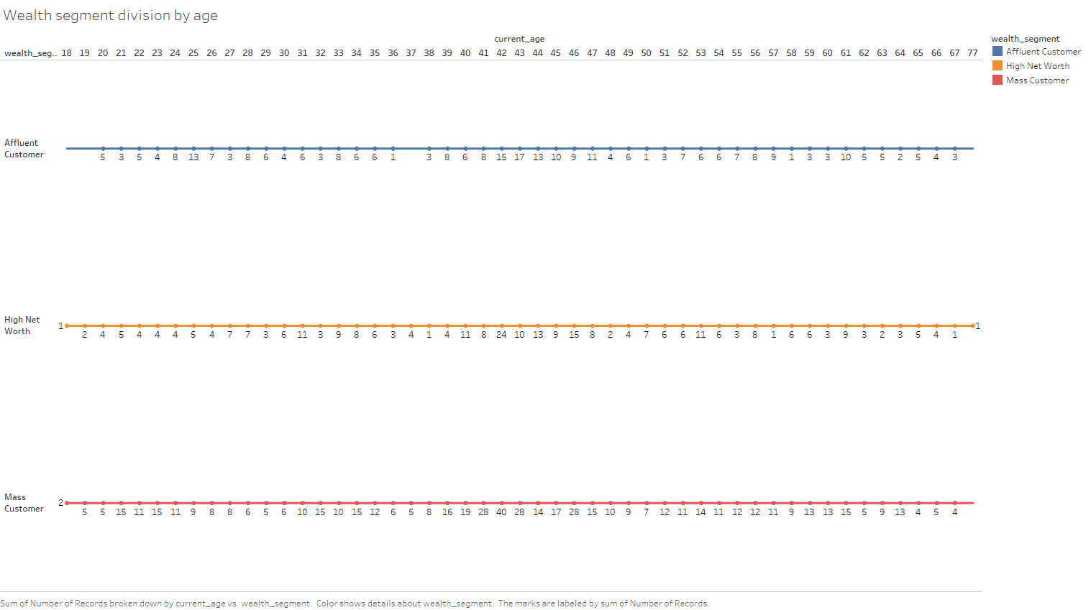
Wealth segmentation by age group

Slide 7
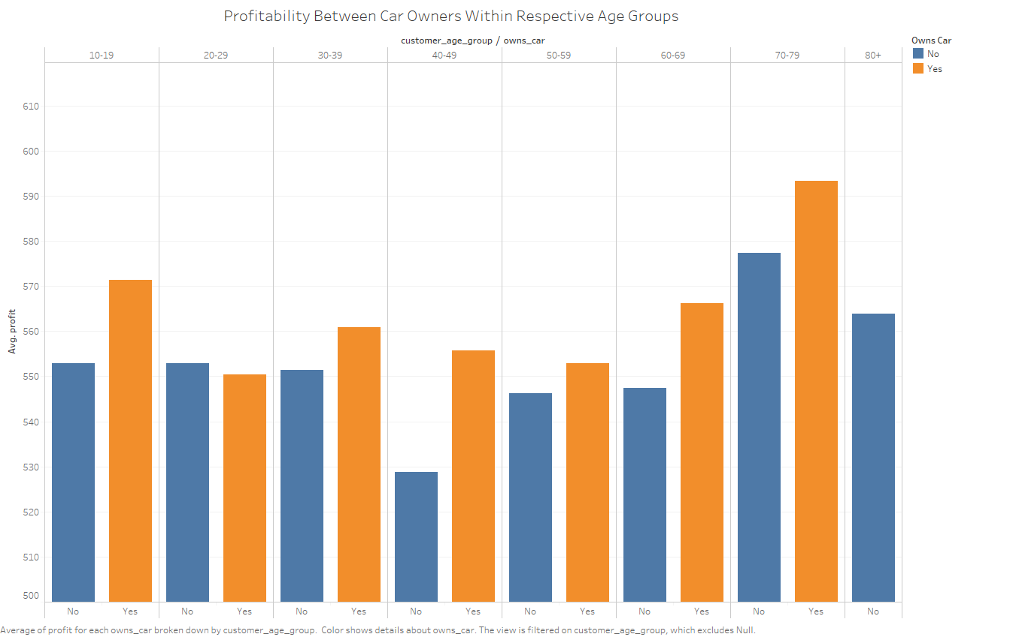
Profitability by car owners division by age groups

Slide 8
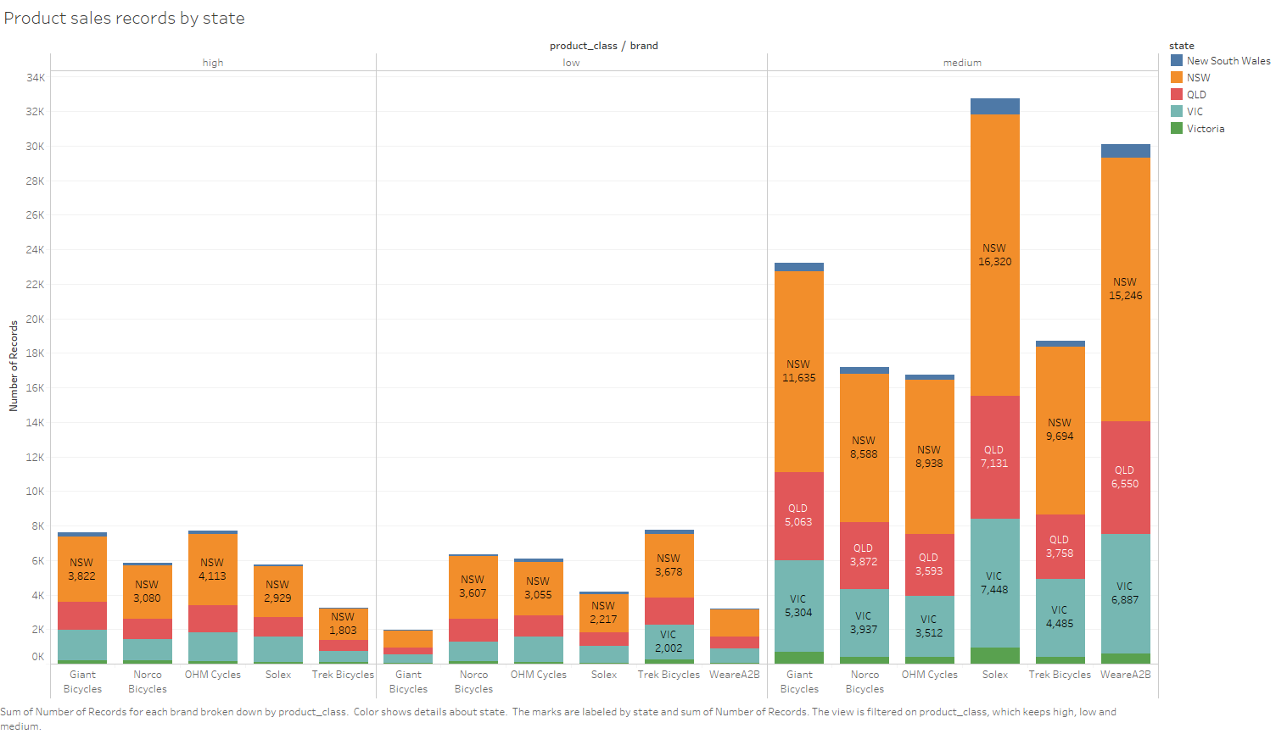
Product sales record by State

Slide 9
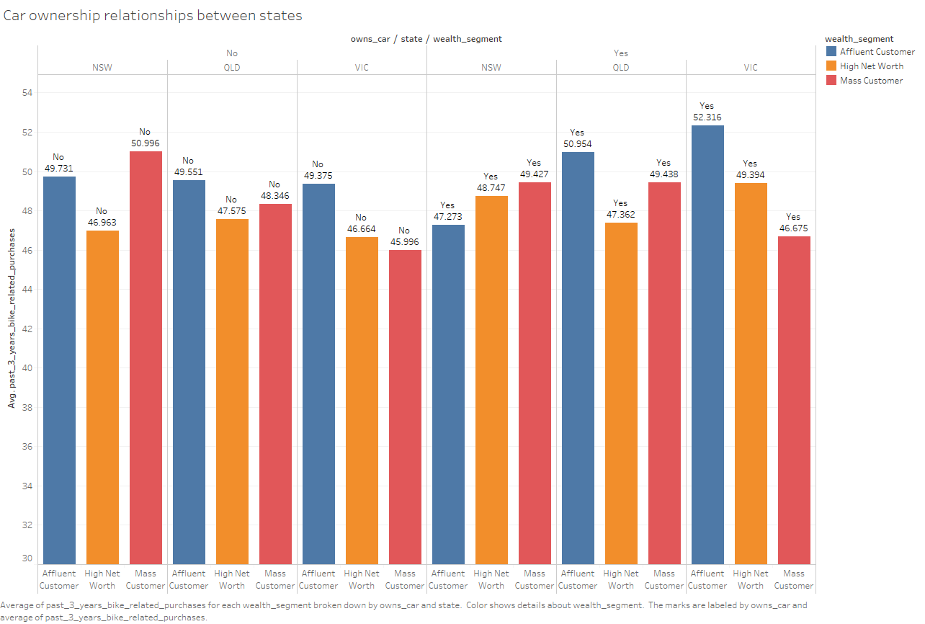
State wise car ownership details

Slide 10
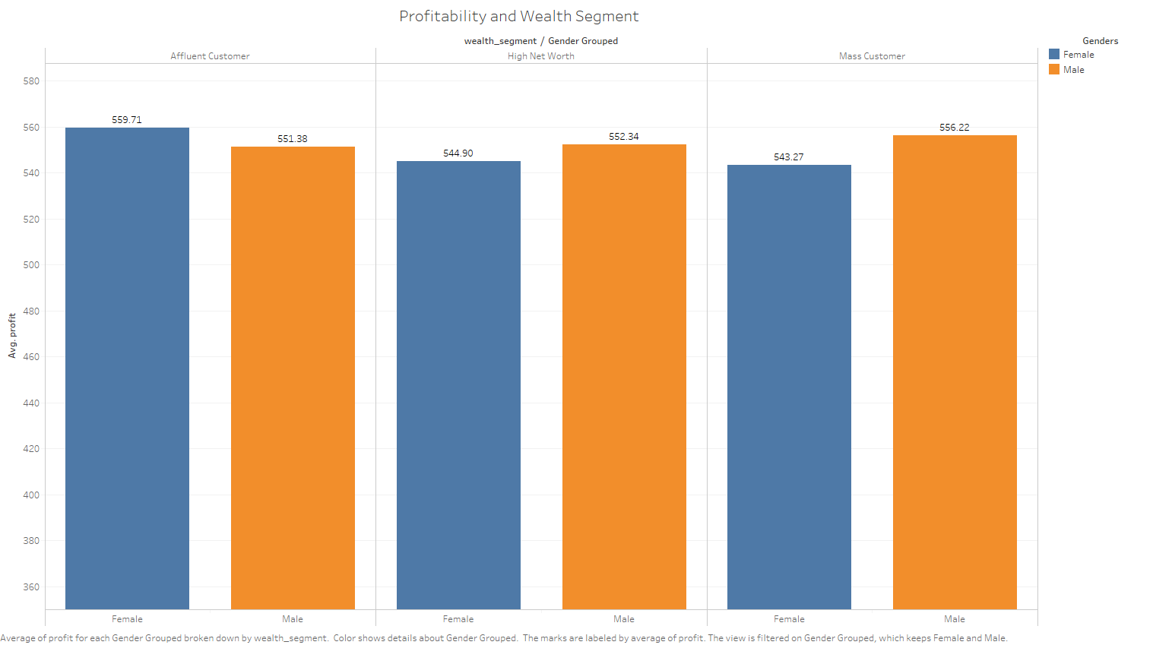
Profitability by wealth segmentation

Slide 11
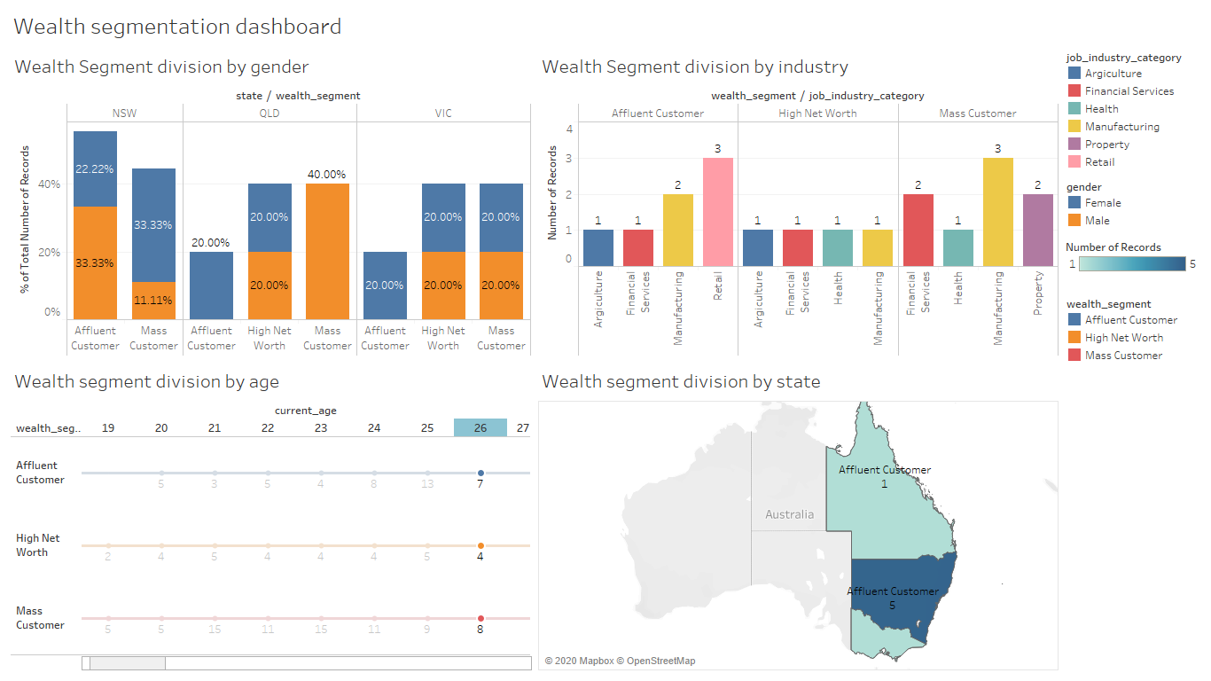

Slide 12
